Slide 1

NLP Term Project: Group 1
Sentiment Analysis
Varun Bhavnani
Sai Anish Kumar Vanka
Lekha Vulavala
Mihir Santosh Nevpurkar
Bhargav Sai Manne

Slide 2


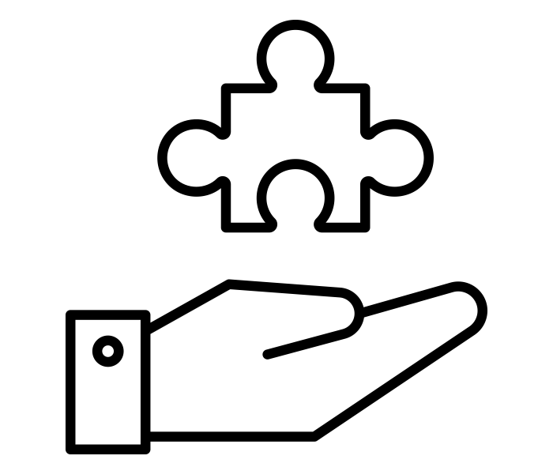

AGENDA
Business
Problems Addressed
Text Processing
Vadar Sentiment Analysis
EDA

Slide 3

Business Problems Addressed

Slide 4




Project Objectives
Reference
Essential steps towards analyzing Risk factors
Project Perspective
Analyzing the sentiment towards the Pfizer vaccine
Conducting a time-series analysis to identify trends and patterns in the sentiment data
Providing insights to help improve vaccine communication strategies
Business Challenges
Technical Challenges
Ensuring the accuracy of sentiment analysis results
Identifying relevant factors that may influence sentiment towards the vaccine
Developing effective communication strategies based on the sentiment analysis results
Handling and cleaning large volumes of data from various sources
Implementing an accurate sentiment analysis algorithm to analyze text data
Dealing with the complexity of time-series analysis and identifying meaningful patterns in the data

Slide 5
Business Problems Addressed
Essential user cases for analyzing sentiments of people
What were the sentiments of people during covid for Pfizer Vaccine?
Did people have positive sentiments towards the Pfizer Vaccine or they have/had negative sentiments?
What are the most common keywords and hashtags for positive sentiments?
What are the most common keywords and hashtags for negative sentiments?

Slide 6

Text Processing

Slide 7
Process Flow
Understanding the text processing steps
Remove Twitter Handles
Remove Hashtags
Remove Single Characters
Remove Extra Spaces
Vader Sentiment Analysis
Notes:
Total rows: 60,000
Features: 78

Slide 8

Sentiment Analysis

Slide 9
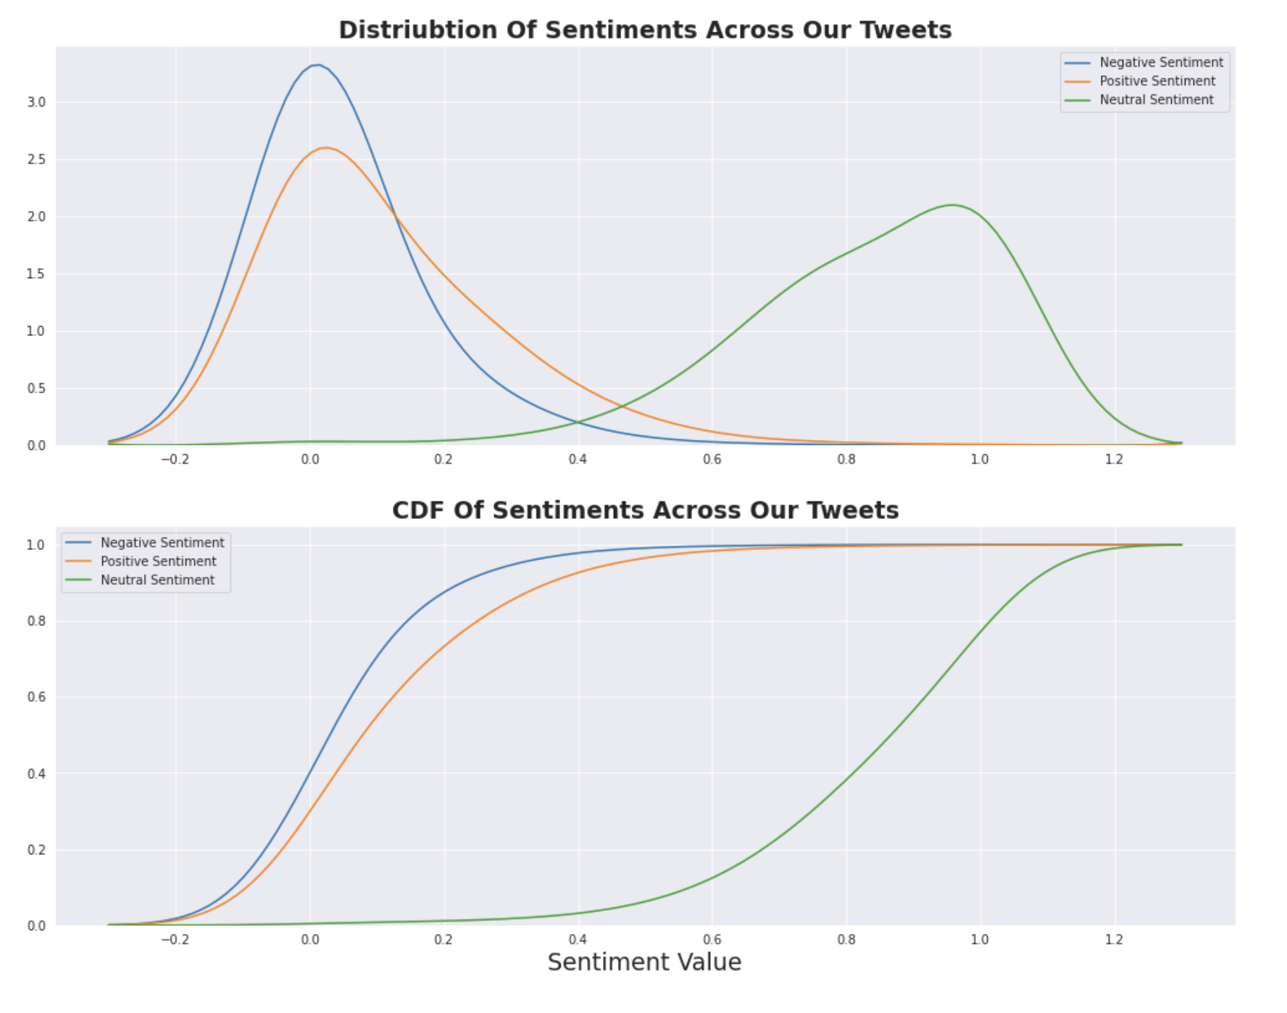
Sentiment Analysis
Overall sentiment of the general population

Slide 10
Exploratory data analysis

Slide 11
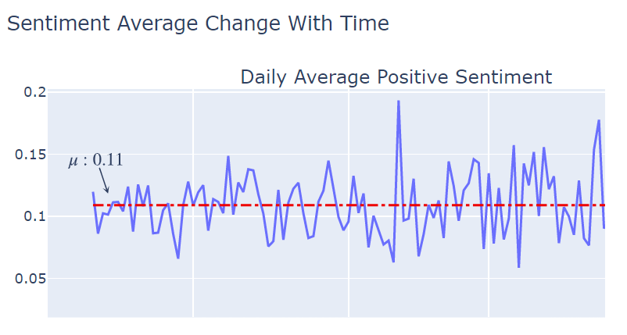
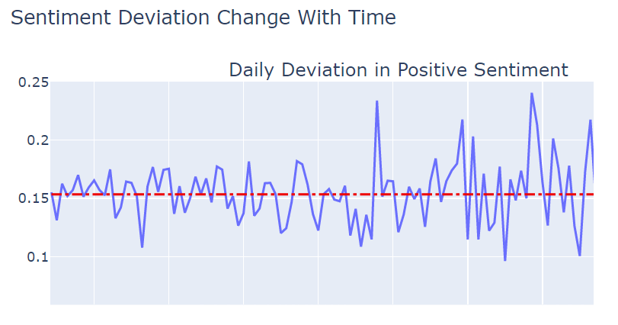
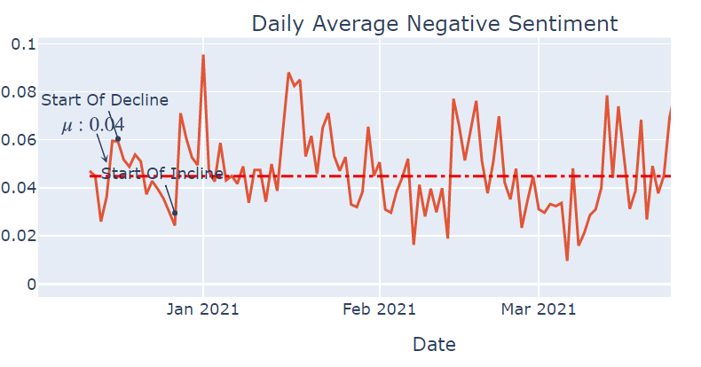
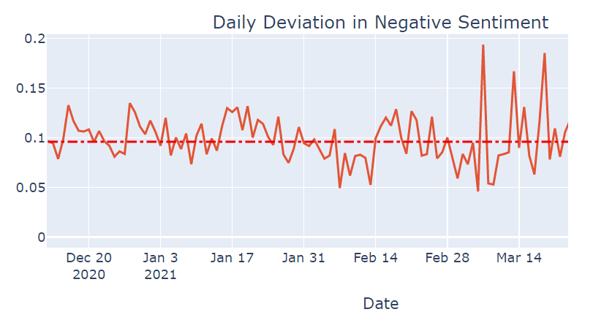
Time based Analysis
Understanding the hindsight & insight from the data

Slide 12
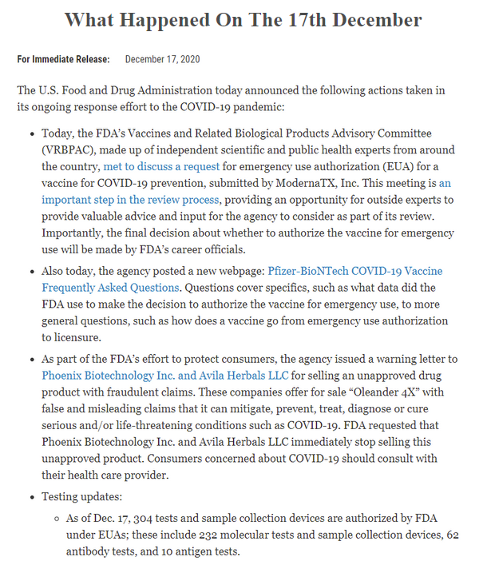
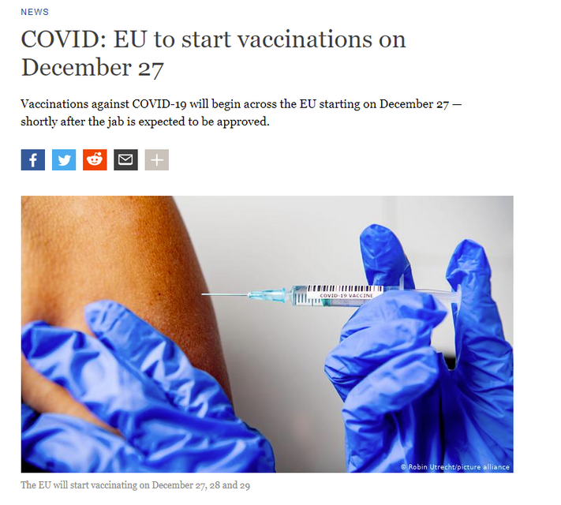
Time based Analysis
Understanding the hindsight & insight from the data

Slide 13
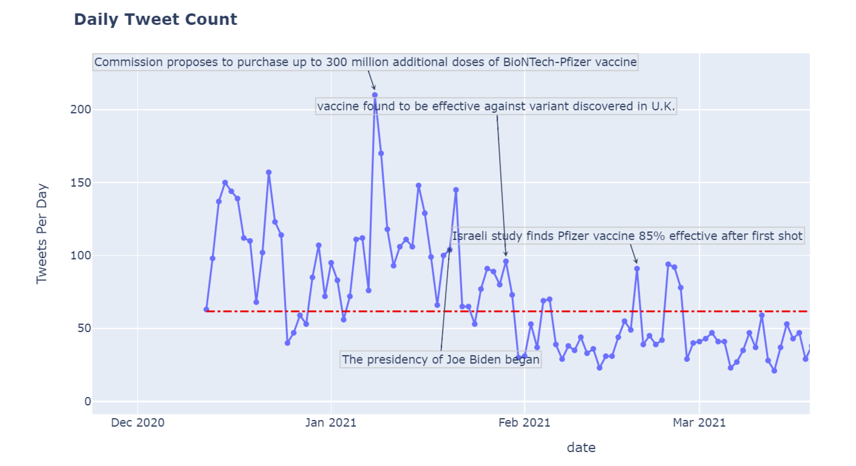
Time based Analysis
Understanding the hindsight & insight from the data

Slide 14
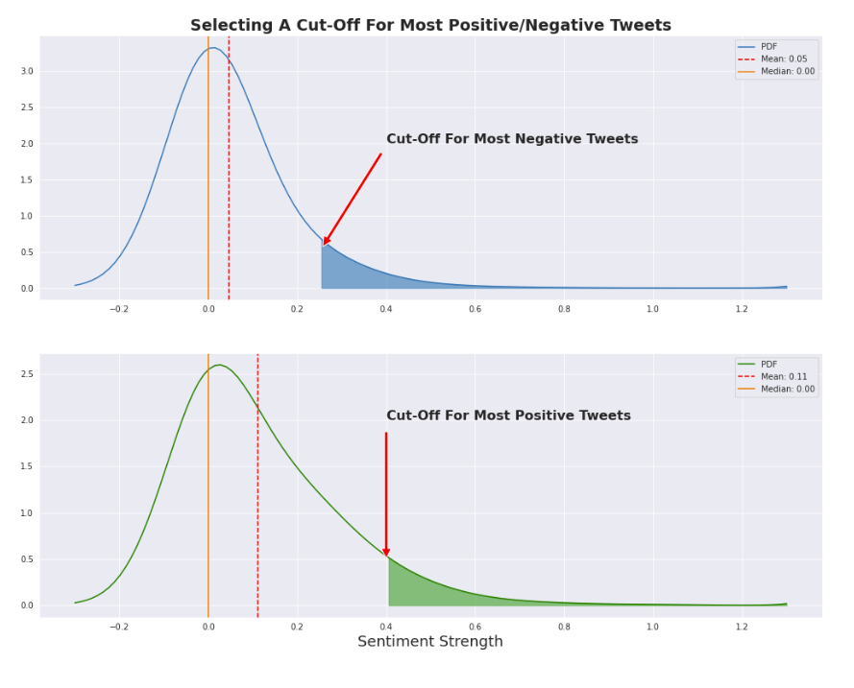
Extreme Sentiment Analysis
Understanding the hindsight & insight from the data
Extreme Sentiments
Extreme sentiments refer to the strongest positive or negative opinions about the Pfizer vaccine expressed in the tweets analyzed.
The majority of extreme sentiments were positive, with more than 80% of extreme sentiments being classified as "very positive".
Extreme sentiments tended to be expressed more frequently by individuals with smaller Twitter followings and fewer verified accounts, suggesting that sentiment analysis may be more representative of public opinion than traditional polls or surveys.

Slide 15
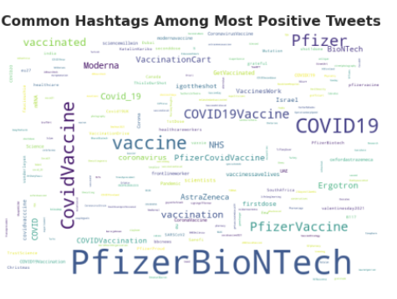
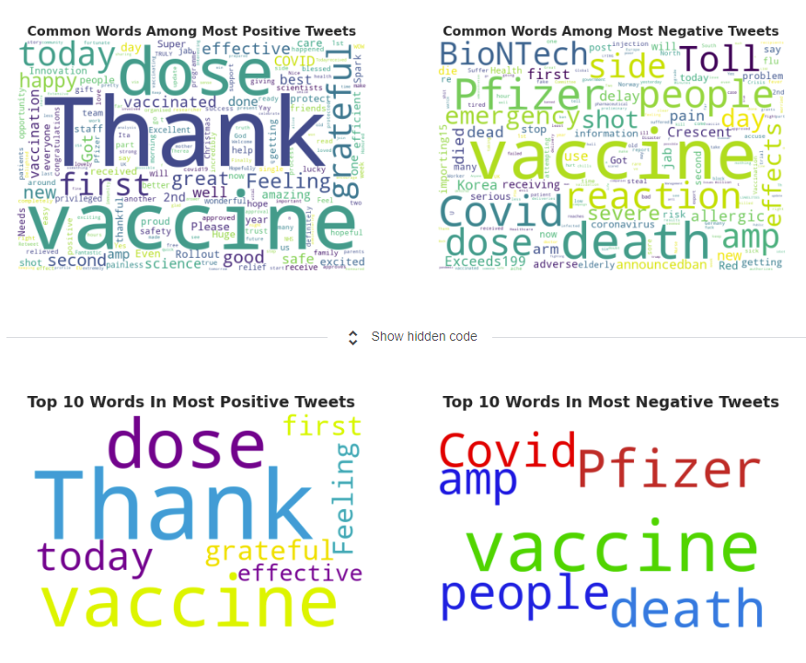
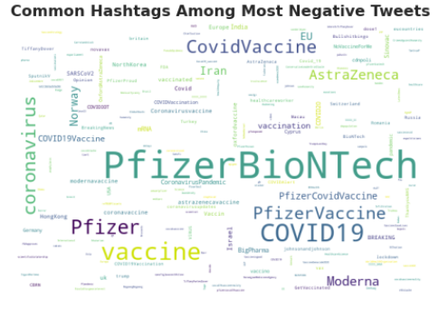
Extreme Sentiment Analysis
Understanding the hindsight & insight from the data

Slide 16
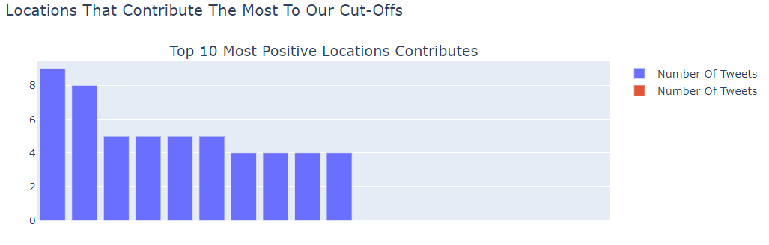
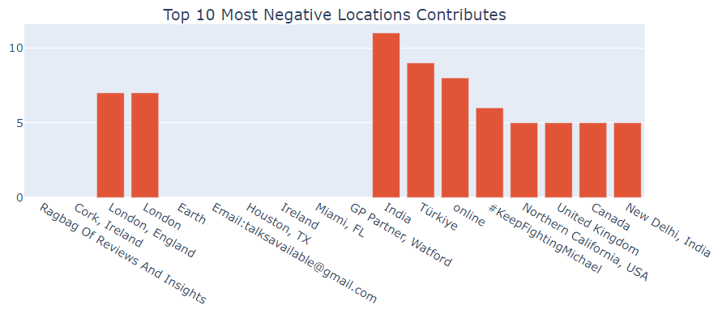
Extreme Sentiment Analysis
Understanding the hindsight & insight from the data

Slide 17
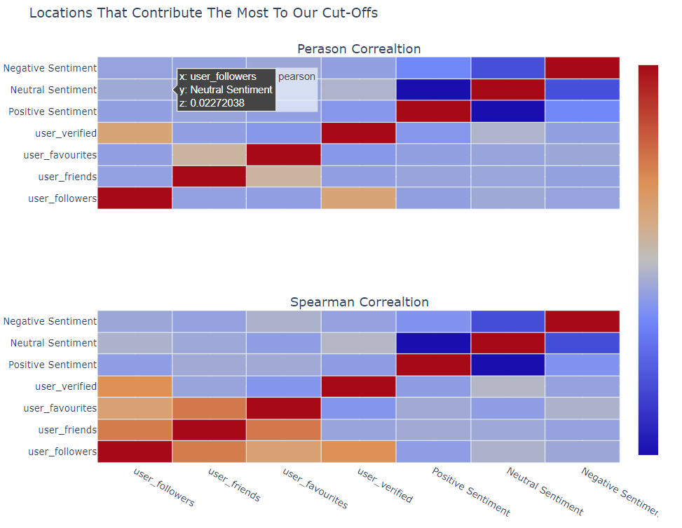
Sentiment Correlation Analysis
Understanding the hindsight & insight from the data

Slide 18
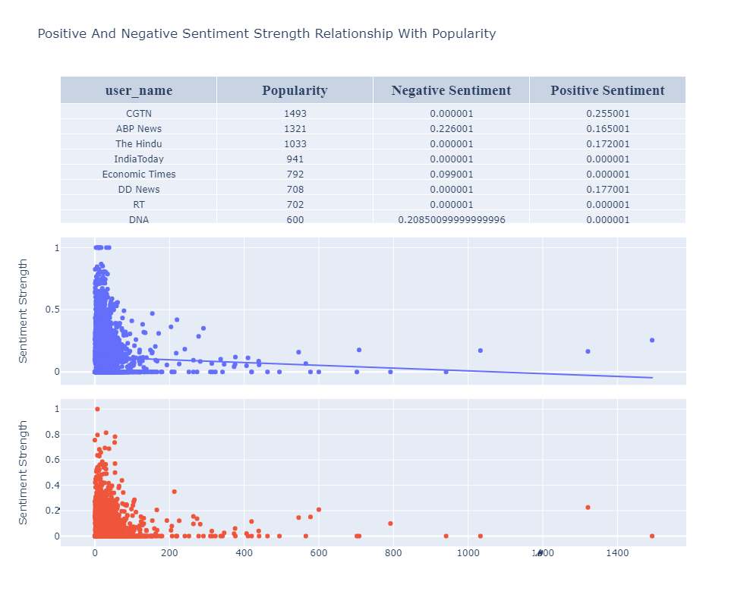
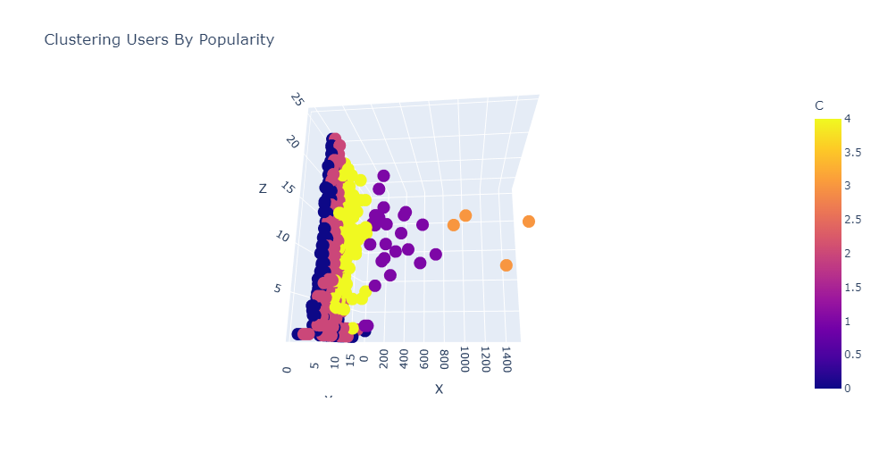
User Analysis
Understanding the hindsight & insight from the data

Slide 19

Conclusion

Slide 20

Analysis Conclusion
Key Insights
Conclusion
There was a significant increase in positive sentiment towards the Pfizer vaccine after it was approved for emergency use by the FDA in December 2020.
The sentiment data suggests that the vaccine has been effective in reducing COVID-19 cases and deaths, which has likely contributed to the increase in positive sentiment.
Time-series analysis revealed a cyclical pattern in sentiment towards the vaccine, with peaks and valleys corresponding to major events such as vaccine approvals, distribution milestones, and media coverage

Slide 21
Thank You
Notes:
Maximizing the value of data for CPG Marketers :
https://www.bcg.com/publications/2020/how-cpg-marketers-can-maximize-value-of-data
Effect of covid on CPG Industry :
https://www.fooddive.com/news/covid-19-has-fundamentally-changed-the-cpg-industry-report-says/596600/
How CPG Brands are using DTC :
https://www.forbes.com/sites/forbescommunicationscouncil/2020/10/08/how-cpg-brands-are-using-dtc-to-stay-competitive/?sh=4286bb4d4fca
Mars Website :
https://www.mars.com/made-by-mars/mars-food
Mars competitors and Revenue Information :
https://www.owler.com/company/mars
Shocking trends in CPG Industry :
https://blog.koupon.com/7-shocking-trends-in-the-cpg-industry?utm_term=&utm_campaign=FSD+DSA+Blog+US+only&utm_source=adwords&utm_medium=ppc&hsa_acc=4619971055&hsa_cam=12471288677&hsa_grp=119201009706&hsa_ad=507806212542&hsa_src=g&hsa_tgt=dsa-1270164446605&hsa_kw=&hsa_mt=b&hsa_net=adwords&hsa_ver=3&gclid=Cj0KCQjwtrSLBhCLARIsACh6Rmh2lrDC70xbyJqZDPPEU-BtuHM6iWzNZrfYVLbI4Tgv5rXHE7gQXikaAhYvEALw_wcB
Dispute between Hershey’s and Mars :
https://munchpak.com/blog/mars-and-hershey-bring-malteser-dispute-to-a-peaceful-close/

